Slide 1
CGB1201 – JAVA PROGRAMMING
Department of Artificial Intelligence and Data Science
Academic Year: 2024 – 2025 (Odd Semester)
Register Number :2303811724322084
Name :PRAVINA M
Year :II-Year
Semester :III-Semester
Section :B
Date :03/12/2024

Slide 2
Title of the Project
COLLEGE HOSTEL BOOKING SYSTEM

Slide 3
Problem Identification
Real-time Room Availability: Students need to see available rooms instantly to avoid booking conflicts. Overbooking Prevention: Ensure rooms aren't double-booked by handling requests in real-time. Booking Prioritization: Some students may have special requirements, and bookings should prioritize based on application date or needs.

Slide 4
Objective
The objective is to create a College Hostel Room Booking System that allows students to view available rooms in real-time, submit booking requests, prevent overbooking, and prioritize assignments based on application date or special needs.

Slide 5
Proposed Architecture
START
STUDENT LOGIN / REGISTER
VIEW AVAILABLE ROOMS
SUBMIT BOOKING REQUEST
CHECK ROOM AVAILABLITY
MANAGE WAITLIST
UPDATE ROOM STATUS
END

Slide 6
Java Programming - Concepts Used
Classes and Objects: Defines the structure of rooms and booking requests. Encapsulation: Protects data by controlling access with methods. Collections: Uses PriorityQueue to manage booking requests based on priority and HashMap to store rooms. Concurrency: Ensures thread safety with synchronized blocks and ReentrantLock.

Slide 7
List of Modules
Room Management Module Booking Request Module Booking Prioritization Module Booking Management Module Concurrency and Synchronization Module Real-Time Availability Update Module Room Status Display Module

Slide 8
Module Description
Room Management Module: Manages room details, including availability and room IDs. Booking Request Module: Handles student booking requests with details like application date and special requirements. Booking Prioritization Module: Prioritizes booking requests based on application date and special requirements.

Slide 9
Module Description (Cont..)
Booking Management Module: Processes and assigns rooms to students, updating availability. Concurrency and Synchronization Module: Ensures thread safety and manages concurrent booking requests. Real-Time Availability Update Module: Updates room availability immediately after a booking is confirmed. Room Status Display Module: Displays the current status of rooms, indicating whether they are available or booked.

Slide 10
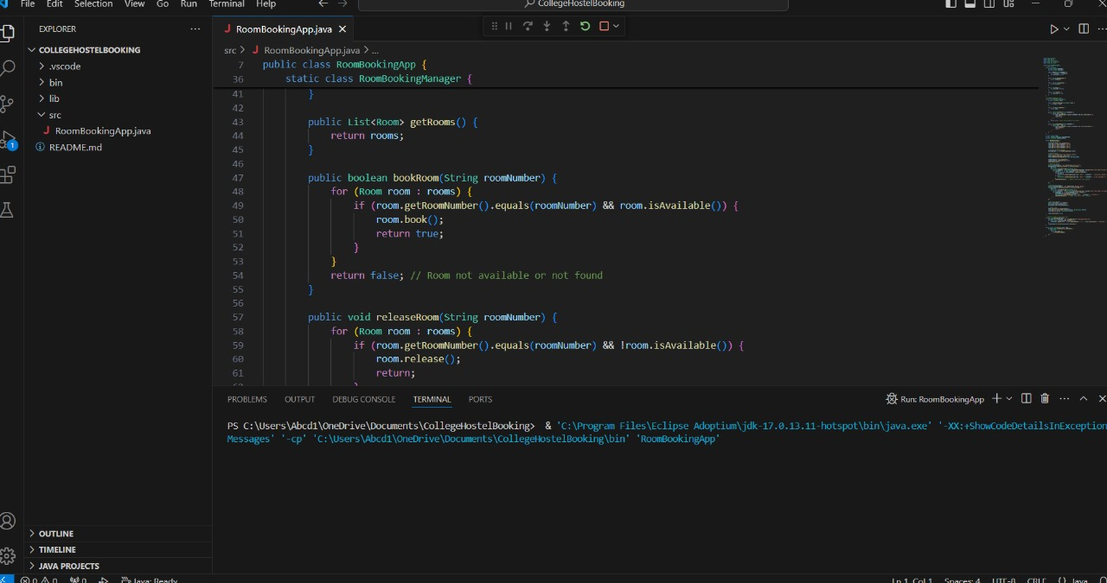
Source Code

Slide 11
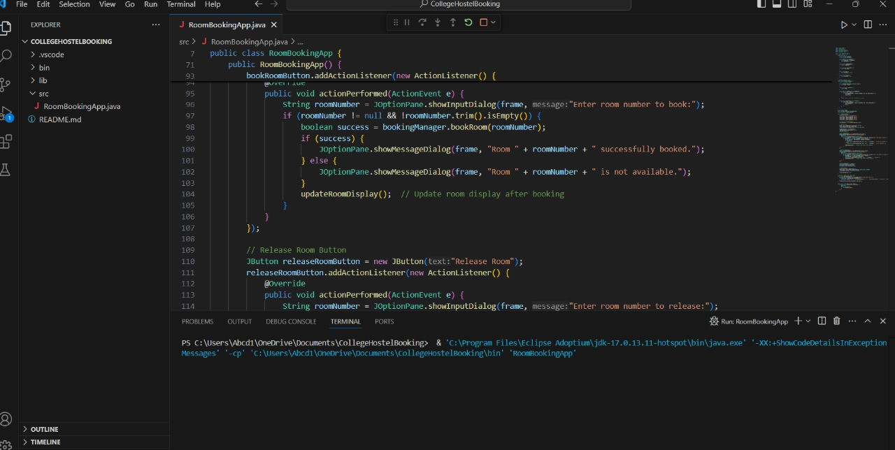
Source Code

Slide 12
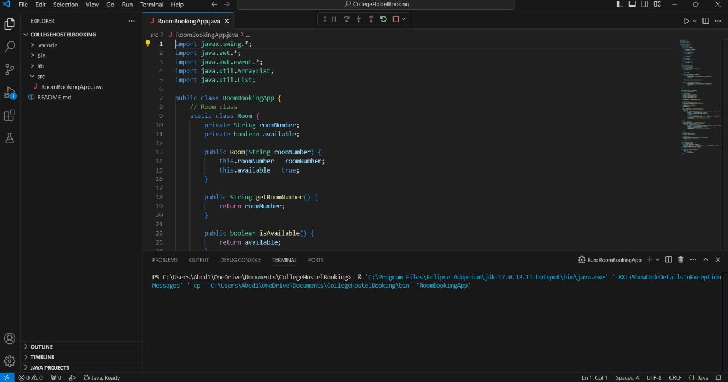
Source Code

Slide 13
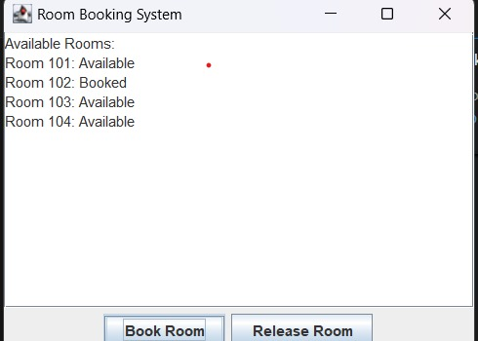
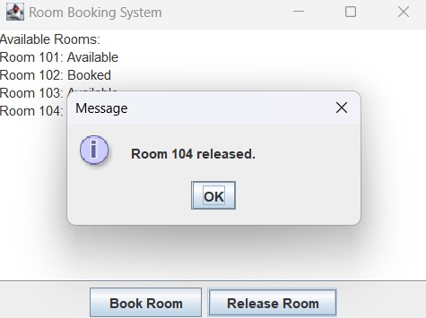
Results

Slide 14
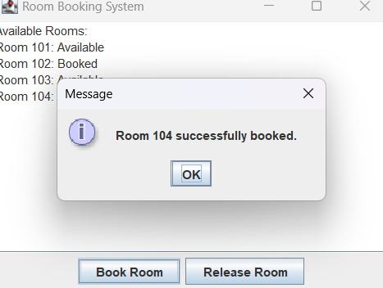

Slide 15
Conclusion
In conclusion, the room booking system efficiently manages reservations, prioritizes requests fairly, and updates availability in real-time. While effective for smaller scales, further improvements in scalability and user interface design would enhance its performance for larger applications.

Slide 16
Thank You
Any queries???

